Slide 1
Neural Networks

Slide 2
Neural Networks:
Neural networks are models of simulation of the human nervous system. Neural network is considered as one of the most useful technique in the world of data analytics.
Neural Networks are drawn for classification, prediction, and pattern detection.
A neural network is a black box in the sense that while it can approximate any function.

Slide 3
Neural Network Architecture:
It refers to the structure and organization of an neural network,
Layers:
Input layers: Layers that take inputs based on existing data. (Predictors)
Hidden layers: Layers that use backpropagation to optimize the weights of the input variables in order to improve the predictive power of the model.
Output layers: Output of predictions based on the data from the input and hidden layers.

Slide 4
Neural Network Architecture:
Neurons (Nodes):
Neurons are the fundamental units that process information. Each neuron takes inputs, applies weights and a bias, runs it through an activation function, and passes the result to the next layer.
Connections and Weights:
Connections are the lines between neurons in one layer to neurons in the next layer. Each connection has a weight, which tells the network how important a given input is.

Slide 5
Neural Network Architecture:
Activation Functions:
Activation functions are a key part of what makes neural networks powerful and flexible. It decides how much influence it should pass on to the next layer.
There are several types of activation functions: linear, sigmoid, ReLU-Rectified Linear Unit, Tanh-Hyperbolic Tangent, Swish, etc.

Slide 6
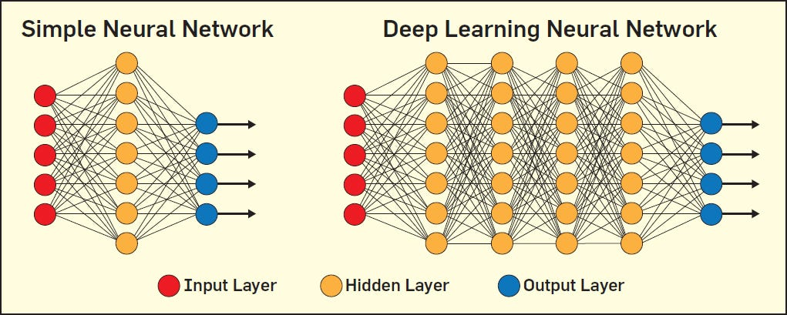
Figure 1 Neural network architecture

Slide 7
Simple Neural Network Architecture:
A very basic form a neural network that only has an input and output layer so no hidden layers, (a single-layer feedforward neural network), for example our output layer is the house price that we’re predicting using some predictors.

Slide 8
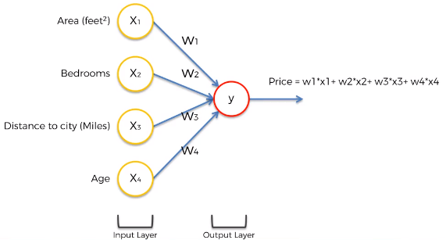
Figure 2 Simple neural network architecture

Slide 9
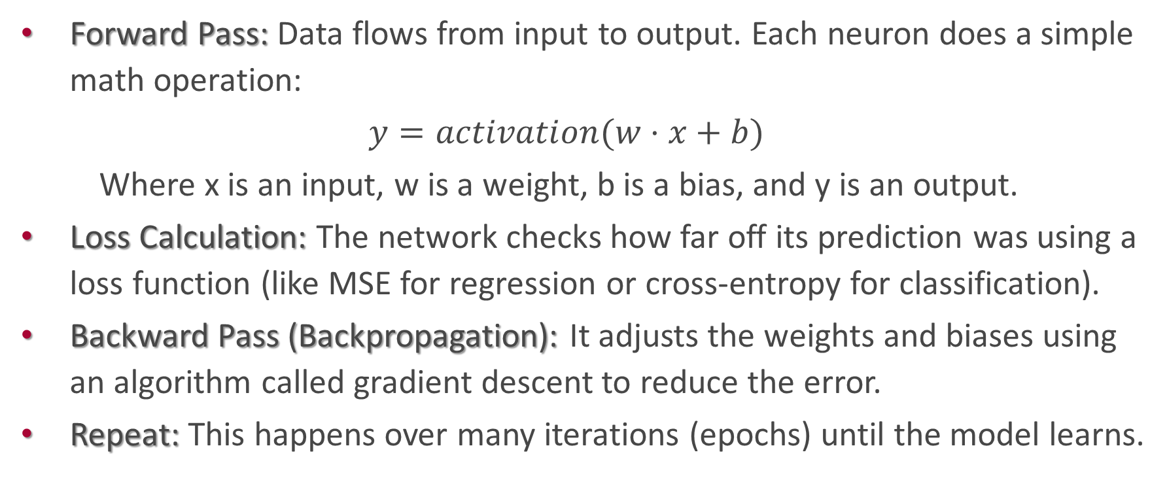
How does Neural Network work?
Forward Pass: Data flows from input to output. Each neuron does a simple math operation:
$$y=activation(w⋅x+b)$$
Where x is an input, w is a weight, b is a bias, and y is an output.
Loss Calculation: The network checks how far off its prediction was using a loss function (like MSE for regression or cross-entropy for classification).
Backward Pass (Backpropagation): It adjusts the weights and biases using an algorithm called gradient descent to reduce the error.
Repeat: This happens over many iterations (epochs) until the model learns.

